Slide 1
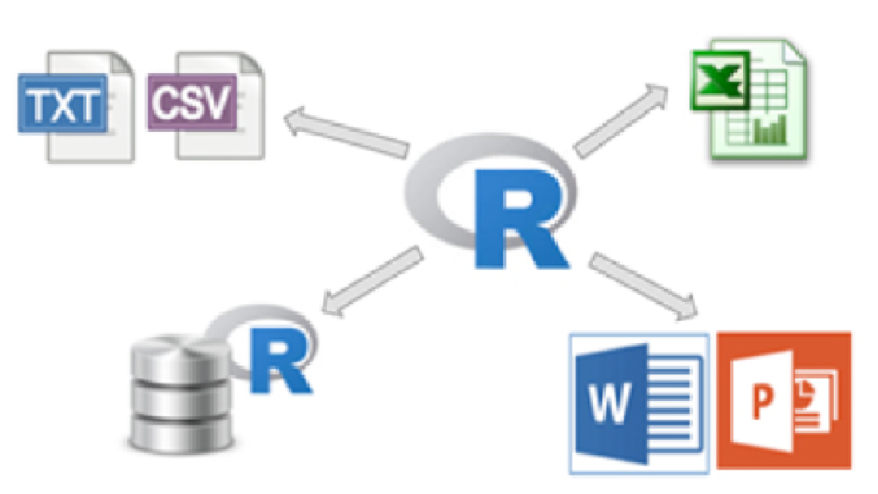
Individual Capstone with R
Project in the context of Data Analyst NTUA Elearning Course

Slide 2
Introduction
Obligatory Statement:
Εγώ ο Βασίλειος Δημητρίου βεβαιώνω ότι η παρούσα εργασία βασίζεται σε δεδομένα για τα οποία έχω άδεια μεταβίβασης και επεξεργασίας. Βεβαιώνω επίσης ότι τα δεδομένα αυτά τηρούν όλους τους ισχύοντες νόμους και διατάξεις περί προστασίας πνευματικής ιδιοκτησίας και προσωπικών δεδομένων.
DataSet:
Index of /ml/machine-learning-databases/breast-cancer-wisconsin (uci.edu) [Wolberg, W. , Street N. and Mangasarian O.. UCI Machine Learning Repository [http://archive.ics.uci.edu/mldatasets/Breast+Cancer+Wisconsin+%28Diagnostic%29]. Irvine, CA: University of California, School of Information and Computer Science.] (UCI Machine Learning Repository: Breast Cancer Wisconsin (Diagnostic) Data Set)

Slide 3
Data – Breast Cancer Tumor Examination
Variable name | Description
Sampldate code number | Sample codified unique number
Clump Thickness | Input variables for each sample - patient
Uniformity of Cell Size
Uniformity of Cell Shape
Marginal Adhesion
Single Epithelial Cell Size
Bare Nuclei
Bland Chromatin
Normal Nucleoli
Mitoses
Class | Output variable – assessment of the doctor for each patient itself - benigh (2) ή malignant (4)

Slide 4
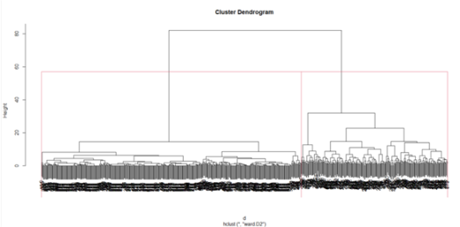


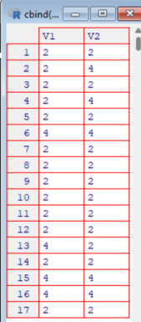
Results (1)
Hierarchical clustering:
Output of 2 Groups
Makes use of the whole dataset to create clusters
Kmeans clustering:
Output 2 Groups
Makes use of the whole dataset to create clusters

Slide 5
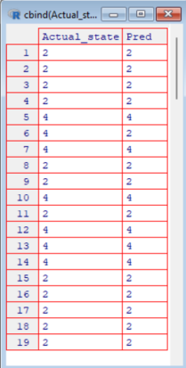
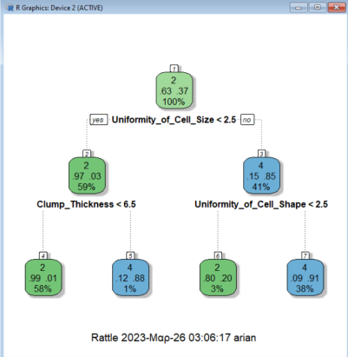


Results (2)
Decision tree:
Makes use of 87% of the whole dataset
Use the rest 13% of the dataset for prediction and model assessment
Comparison of hierarchical clustering and tree model on the same dataset portion - almost same prediction result:

